Slide 1
Improvement Cost Reduction Processes
Angela Harris
National University
MGT/603- Business Operation Management
Professor Simon Dekker
October 21, 2019

Slide 4
Introduction
The task force for Global Health is an international organization found in America.
The organization is driven by a commitment to attain health equality.
The company also collaborate with both governmental and non-governmental organizations such as pharmaceutical institution, the task force partners and ministry of public health to deliver services and required resources to deal with large scale health problems in international level.
The task force is all about collaboration, smart solution, and compassion that is focused on solving global health problems.
The fund received is used for a massive campaign to purchase resources that are used to help global health care activities

Slide 5
The organization and its partners work to eliminate three NTDs, namely river blindness, lymphatic's filariasis, and blinding trachoma by the end of 2030.
The organization also donate millions of money each year in a different part of the world to eliminate these disease and save millions of lives (Rogers 1973).
The above diseases are a burden to the population and generation to come (Mosley 1983).
The organization received more than $2 million in funding by a nonprofit organization and has been awarded a Humanitarian price in the last two decades (McInnis, & Merajver 2011)

Slide 6
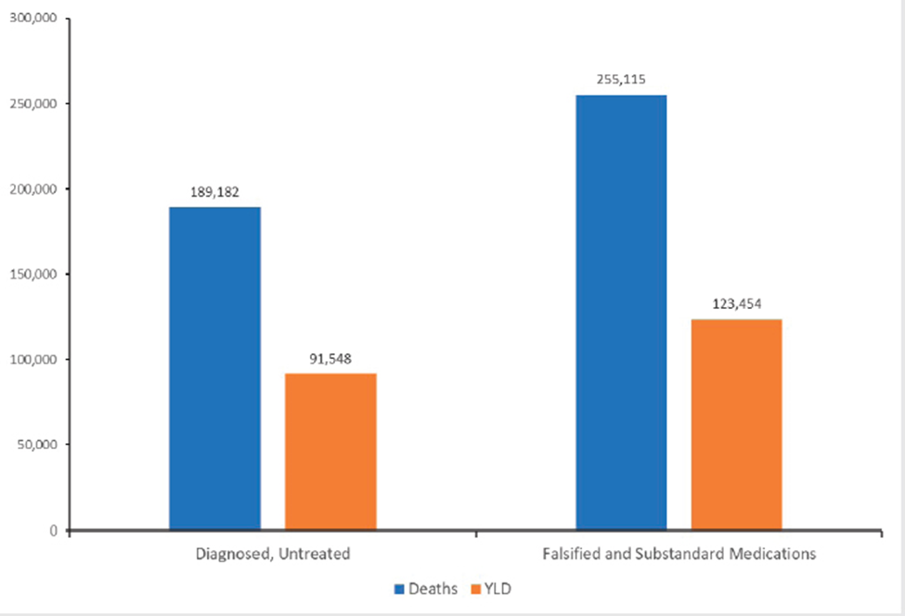
A bar graph showing people affected by the disease in the US

Slide 7
Cost Reduction Process Improvement
One of the strategies in the task force for global health care is cost reduction process improvement.
The objective of the organization is to improve hospital productivity as a way to reduce operational costs.
In 2007 the spending cost increased up to 4 percent totaling $4 trillion of gross domestic product.
It has also estimated that more than 25 percent can be attributed to wasteful spending that includes spending for things that are not necessary such as fraud, excess administrative cost, and buying of equipment with high prices (Rogers 1973).

Slide 8
The organization has two ways to minimize the cost: increase productivity or use fewer services. The organization has mostly focused on using fewer services.
This is the best strategy because the organization most overuse many services, while another function is not useful. The organization also reduces its cost problem by consuming less (McInnis, & Merajver 2011).
To increase productivity within the organization, technology, and management department must be updated every time to maximize their production (Rogers 1973).

Slide 9
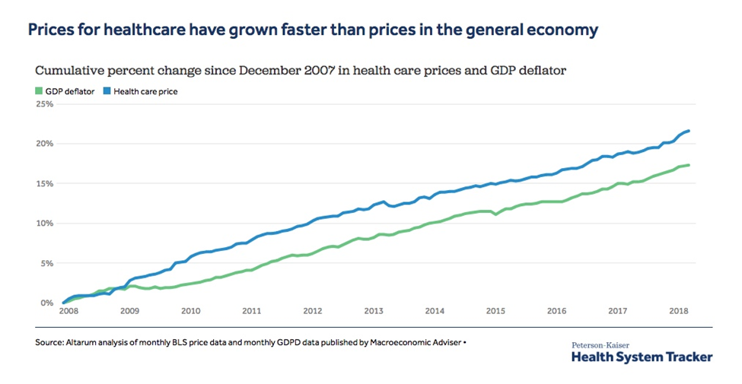
Graph showing time (years) against cumulative percentage change in healthcare.

Slide 10
inefficiencies of the current condition
Unnecessary care is found in almost all healthcare organizations that increase health care costs, where hundreds of millions of dollars are drained.
Wastage of money, recent research by the institute of medicine health shows that more than a third of health costs go to waste (McInnis, & Merajver 2011).
Perverse incentives on how people pay for health care services.
Avoidable harm to patients is one of the common problems in health care.
Private Health insurance and the lack of insurance

Slide 11
Proposed Improvement/Solution
Develop a health improvement strategy, Some systems can achieve short term changes where they show improvements in health activities that can be seen over a long period.
Inventory health resources, The community must access health care resources when they have a health problem
Analyzing the health problem, the community that is prepared to solve health issues must investigate the health problems through various departments such as health plan

Slide 12
Focusing on microsystems
This is the one strategy that every healthcare must aim to implement. The microsystem may be referred to as small units such as administrators, caregivers, and workers who contribute to the delivery of healthcare services (David & James 2013).
. Microsystems in healthcare deliver quality improvements in intervention for successful scalability. Healthcare centers should adopt the strategy to spread the word within their culture and structure (McInnis, & Merajver 2011).

Slide 13
Conclusion
In conclusion, the paper has analyzed the cost reduction process improvement in health care organizations.
Wastage of money and resources also affect services delivery in medical centers as unnecessary are bought.
Developing a health program strategy will also help to increase service delivery in a medical practice where the right procedures are used to deliver the services.
Great use of modern strategy will help to improve services in any healthcare institution. I would recommend that health organizations apply the above factors to reduce inefficiency service delivery.

Slide 14
Reference
David A. Collier & James R Evans (2013). OM⁴ or OM⁶ South Western Cengage: Boston, MA. ISBN- 13: 978- 1- 133- 37242- 4
Rogers, E. M. (1973). Communication strategies for family planning.
Schoonveld, E. (2016). The price of global health: drug pricing strategies to balance patient access and the funding of innovation. Routledge.

